Slide 1
MOS Capacitor
MOS: Metal-Oxide-Semiconductor
V_{g}
V_{g}
gate
metal
gate
SiO₂
SiO₂
N⁺
N⁺
Si body
P-body
MOS capacitor
MOS transistor

Slide 2
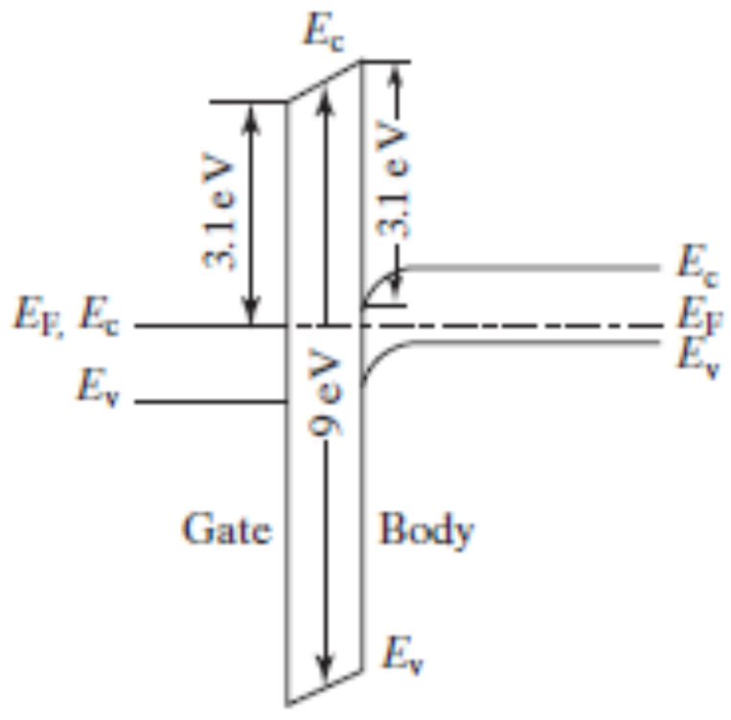
MOS Capacitor
E_{c}
E_{c}
n
y
o
d
E_{f} , E_{c}
E_{f}
c
o
i
l
b
i
E_{v}
s
O
2
E_{v}
y
n
l
i
o
o
S
c
p
i
l
+
i
N
S
-
Gate
Si Body
P
E_{v}
This energy-band diagram for V_{g} = 0 is not the simplest one.

Slide 3
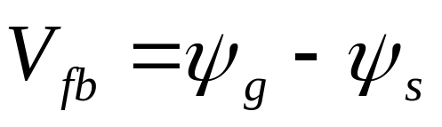
Flat-band Condition and Flat-band Voltage
E
0
χ
=0.95 eV
SiO
2
E
c
q
ψ
g
q
ψ
=
χ
+ (
E
–
E
)
3.1 eV
3.1 eV
χ
Si
s
Si
c
f
=4.05eV
E
c
,
E
E
f
q
V
c
fb
E
E
f
v
E
v
N
+
-poly-Si
9 eV
P-body
The band is flat at the flat band voltage.
E₀ : Vacuum level
E₀ – E_{f} : Work function
E₀ – E_{c} : Electron affinity
Si/SiO₂ energy barrier
4.8 eV
E
v
SiO
2

Slide 4
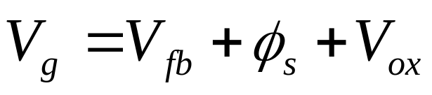
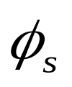
Surface Accumulation
Make V_{g} < V_{fb}
3.1eV
V
E
E
ox
c
,
f
φ_{s} : surface potential, band bending
V_{ox}: voltage across the oxide
E
E
v
0
qV
g
q
φ
s
E
c
E
is negligible when
E
f
the surface is in accumulation.
v
M
O
S

Slide 5
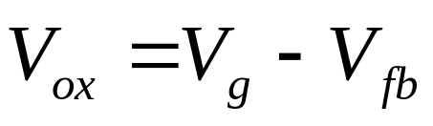
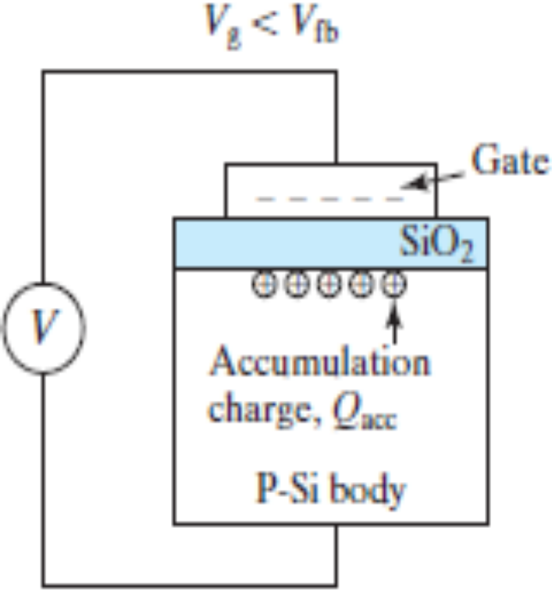
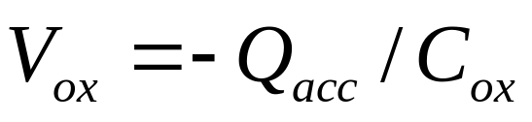
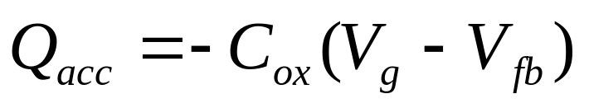
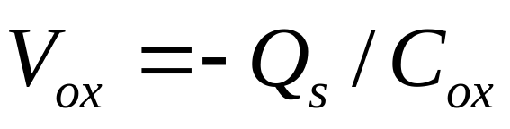
Surface Accumulation
V_{g} <V_{t}
Gauss’s Law

Slide 6
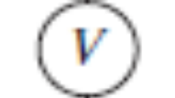
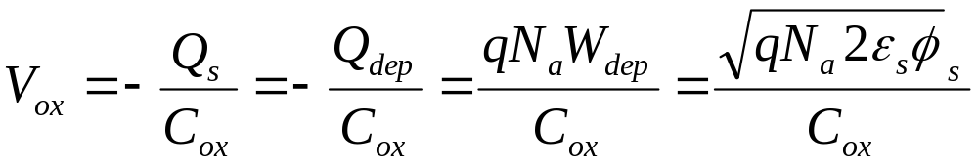
Surface Depletion ( )
V
g
>
V
fb
qV
ox
E
c
gate
q
φ
s
+ + + + + +
-
E
SiO
-
f
-
E
- - - - - - -
2
-
v
- - - - - - -
qV
- - - - - - -
g
W
V
depletion layer
E
E
dep
c
,
f
depletion
charge,
Q
dep
region
E
v
P-Si body
M
O
S

Slide 7
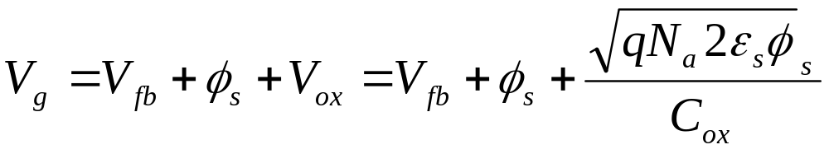
Surface Depletion
This equation can be solved to yield φ_{s} .

Slide 8
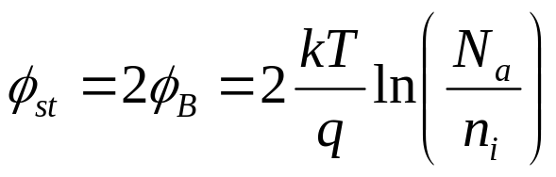
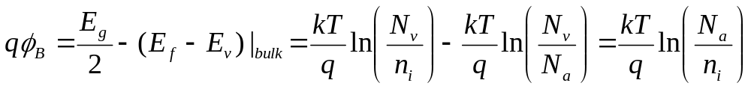
Threshold Condition and Threshold Voltage
Threshold (of inversion):
n_{s} = N_{a} , or
(E_{c}–E_{f})_{surface}= (E_{f} – E_{v})_{bulk} , or
 A=B, and C = D
E
c
φ
st
E
i
=
φ
A
C
q
Β
D
E
f
B
E
qV
=
qV
v
g
t
E
c
,
E
f
E
v
M
O
S

Slide 9
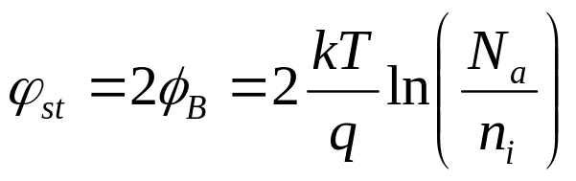
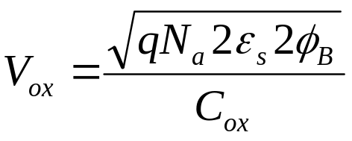
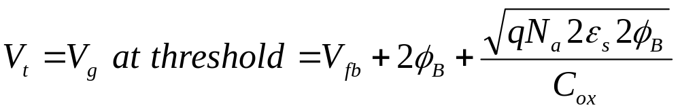
Threshold Voltage
V
=
V
+
φ
+
V
g
fb
s
ox
At threshold,

Slide 10
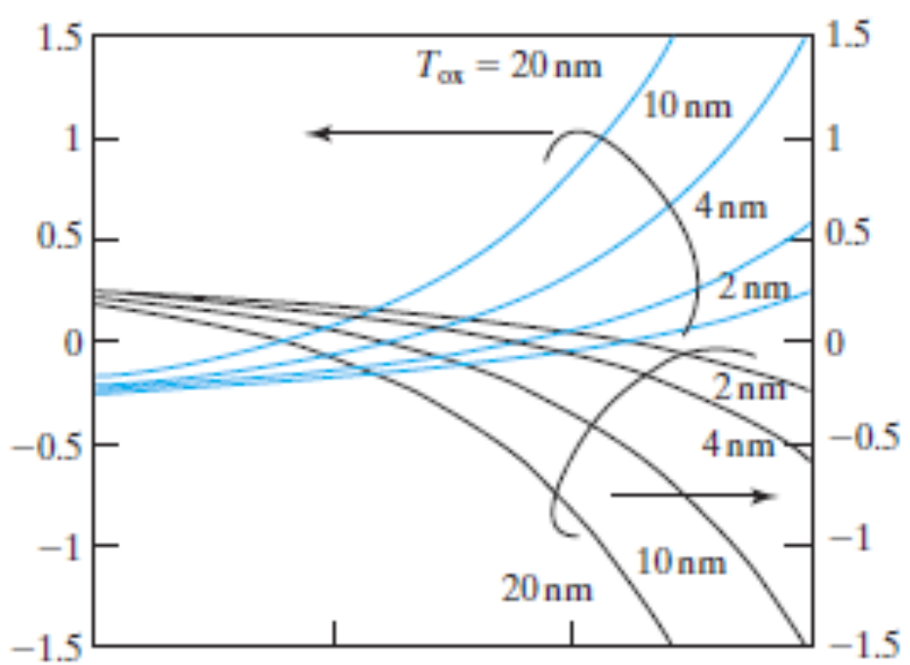
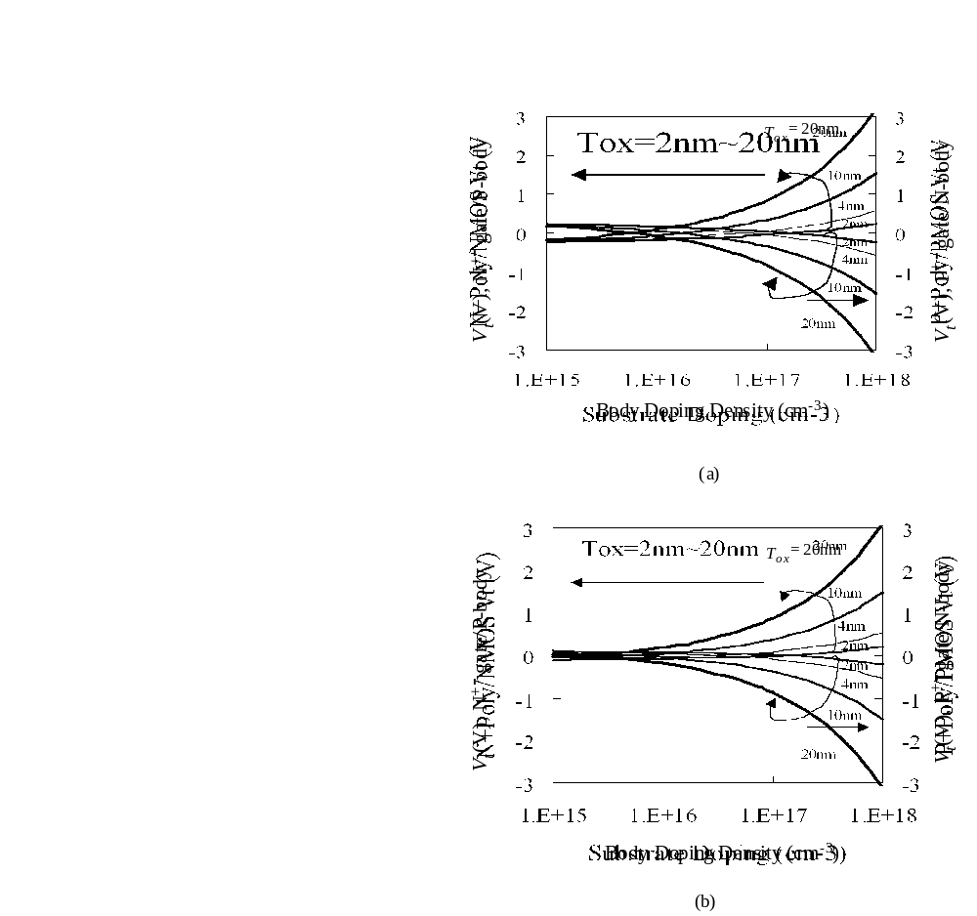
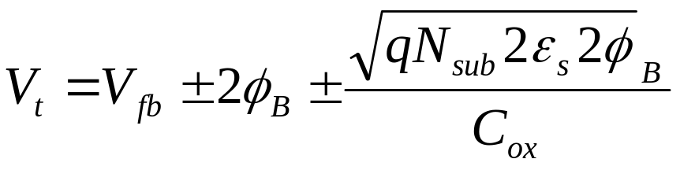
Threshold Voltage
+ for P-body,
– for N-body

Slide 11
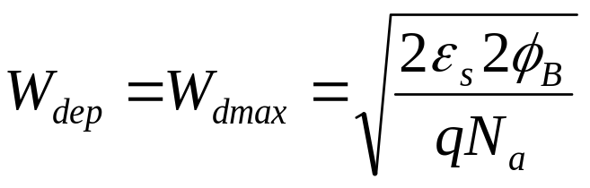

Strong Inversion–Beyond Threshold
V_{g} > V_{t}
V
>
V
-
E
c
g
t
E
-
f
-
E
gate
-
v
-
-
++++++++++
qV
SiO
g
-
-
-
-
-
-
-
-
2
V
- - - - - - -
E
c
,
E
f
Q
Q
E
dep
inv
v
P
-
Si substrate
M
O
S

Slide 12
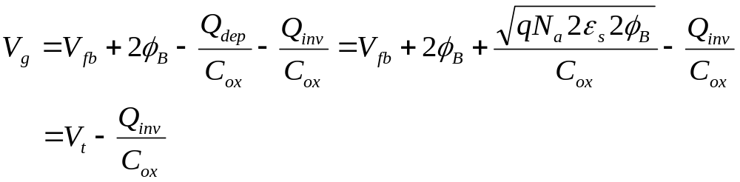
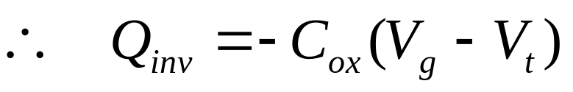
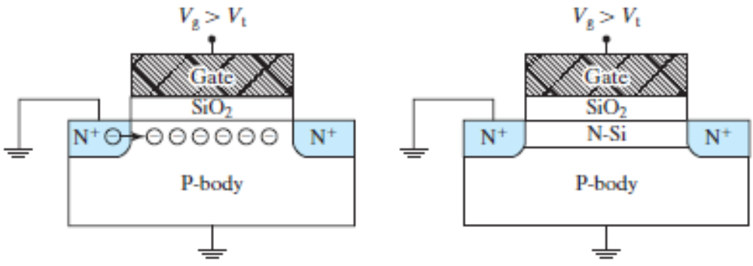
Inversion Layer Charge, Q_{inv} (C/cm²)
V_{g} > V_{t}
V_{g} > V_{t}

Slide 13
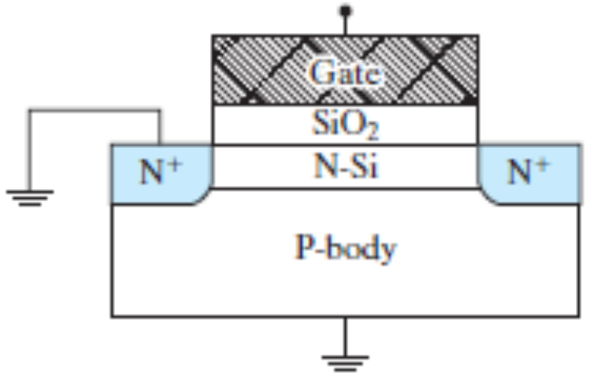
Choice of V_{t} and Gate Doping Type
V_{t} is generally set at a small positive value so that, at V_{g} = 0, the transistor does not have an inversion layer and current does not flow between the two N⁺ regions
P-body is normally paired with N⁺-gate to achieve a small positive threshold voltage.
N-body is normally paired with P⁺-gate to achieve a small negative threshold voltage.

Slide 14
Review : Basic MOS Capacitor Theory
φ_{s}
2φ_{B}
V_{g}
V_{fb}
V_{t}
accumulation
depletion
inversion
W_{dep}
W
dmax
W
= (2
ε
2
φ
/
1/2
dmax
s
Β
q
Ν
a
)
∝
(
φ
)
1/2
s
V_{g}
accumulation
V_{fb}
depletion
V_{t}
inversion

Slide 15
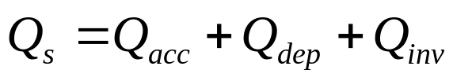
Review : Basic MOS Capacitor Theory
Q_{dep}=- qN_{a}W_{dep}
V_{fb}
total substrate charge, Q_{s}
accumulation
depletion
inversion
V_{g}
(a)
0
V_{t}
–qN_{a}W_{dep}
–qN_{a}W_{dmax}
Q_{inv}
Q_{s}
accumulation
depletion
inversion
accumulation
depletion
inversion
(b)
V_{fb}
V_{t}
V_{g}
regime
regime
regime
slope = − C_{ox}
V_{fb}
0
V_{g}
V_{t}
Q_{acc}
slope = − C_{ox}
Q_{inv}
(c)
slope = − C_{ox}
V_{fb}
V_{t}
V_{g}
accumulation
depletion
inversion

Slide 16
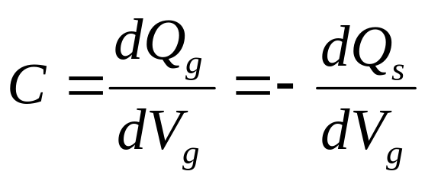
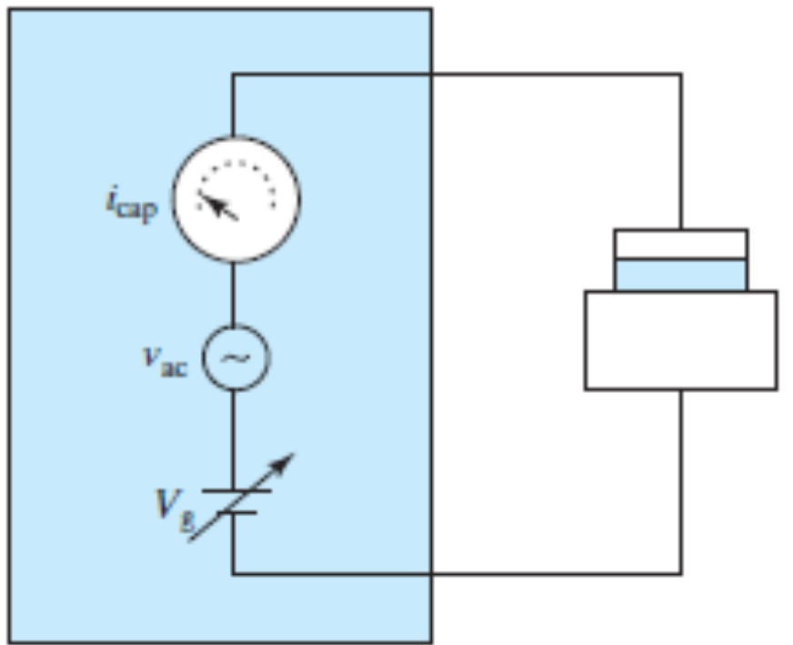
MOS CV Characteristics
MOS Capacitor
C-V Meter

Slide 17
MOS CV Characteristics
Q_{s}
accumulation
depletion
inversion
C
regime
regime
regime
C_{ox}
V_{fb}
V_{g}
0
V_{t}
Q_{inv}
slope = − C_{ox}
V_{fb}
V_{t}
V_{g}
accumulation
depletion
inversion

Slide 18
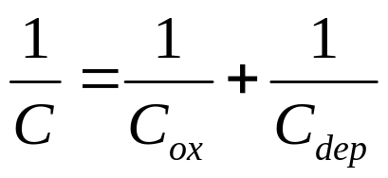
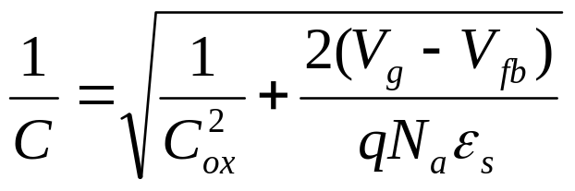
CV Characteristics
C
C_{ox}
V_{g}
accumulation
V_{fb}
depletion
V_{t}
inversion
In the depletion regime:

Slide 19
Supply of Inversion Charge May be Limited
gate
gate
C
ox
C
ox
+
+
+
+
+
+
+
+
+
C
W_{dep}
-
-
-
-
-
dep
-
Accumulation
Depletion
P-substrate
P-substrate
gate
gate
C
ox
C
ox
N
+
-
-
-
-
-
-
-
-
DC
-
-
-
-
-
-
-
-
-
Inversion
-
C
-
dmax
- -
-
W_{dmax}
AC
Inversion
W
DC and AC
dmax
P-substrate
P-substrate
In each case, C = ?

Slide 20
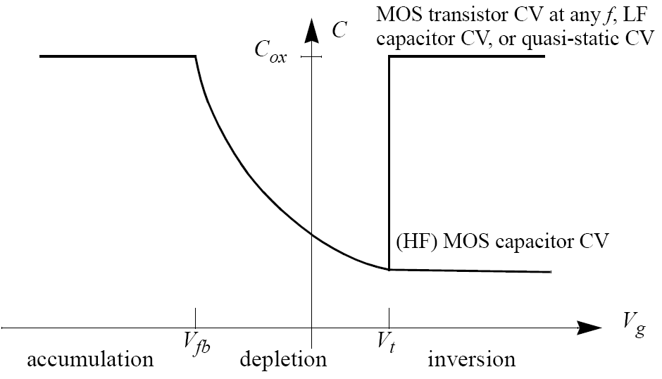
Capacitor and Transistor CV (or HF and LF CV)

Slide 21
Quasi-Static CV of MOS Capacitor
C
C_{ox}
V_{g}
accumulation
V_{fb}
depletion
V_{t}
inversion
The quasi-static CV is obtained by the application of a slow linear-ramp voltage (< 0.1V/s) to the gate, while measuring I_{g} with a very sensitive DC ammeter. C is calculated from I_{g} = C·dV_{g}/dt. This allows sufficient time for Q_{inv} to respond to the slow-changing V_{g} .

Slide 22
EXAMPLE : CV of MOS Capacitor and Transistor
C
MOS transistor CV,
QS CV
Does the QS CV or the HF capacitor CV apply?
HF capacitor CV
V_{g}
(1) MOS transistor, 10kHz. (Answer: QS CV).
(2) MOS transistor, 100MHz. (Answer: QS CV).
(3) MOS capacitor, 100MHz. (Answer: HF capacitor CV).
(4) MOS capacitor, 10kHz. (Answer: HF capacitor CV).
(5) MOS capacitor, slow V_{g} ramp. (Answer: QS CV).
(6) MOS transistor, slow V_{g} ramp. (Answer: QS CV).

Slide 23
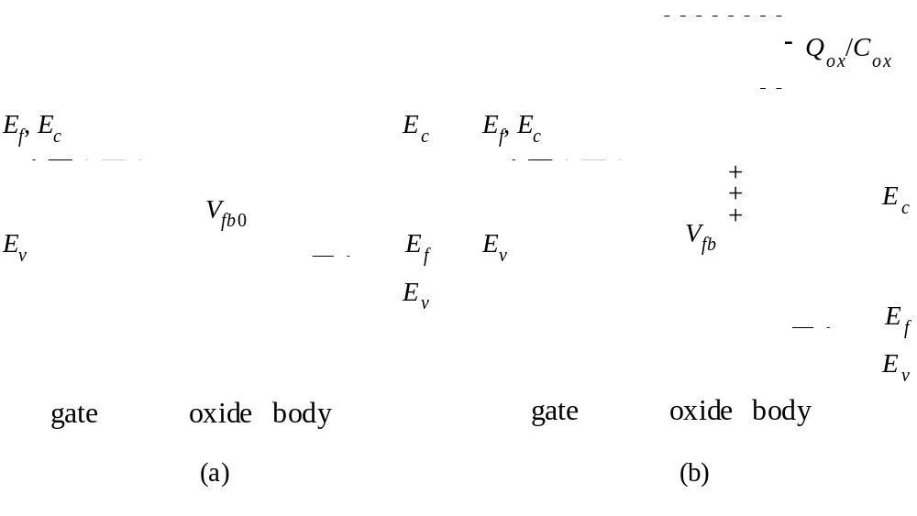
Oxide Charge–A Modification to V_{fb} and V_{t}

Slide 24
5.7 Oxide Charge–A Modification to V_{fb} and V_{t}
Types of oxide charge:
Fixed oxide charge, Si⁺
Mobile oxide charge, due to Na⁺contamination
Interface traps, neutral or charged depending on Vg.
Voltage/temperature stress induced charge and traps--a reliability issue

Slide 25

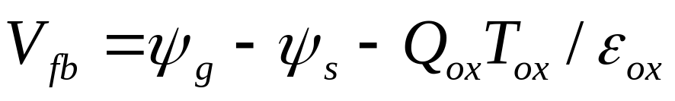
EXAMPLE: Interpret this measured V_{fb} dependence on oxide thickness. The gate electrode is N⁺ poly-silicon.
V_{fb}
10 nm
20 nm
30 nm
T_{ox}
0
–0.15V
–0.3V
What does it tell us? Body work function? Doping type? Other?
Solution:

Slide 26
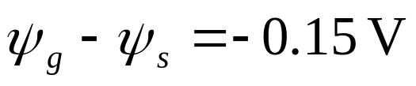
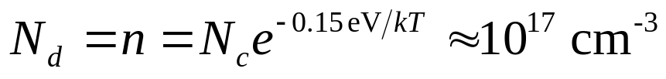

from intercept
E
, vacuum level
0
ψ
ψ
=
ψ
+ 0.15V
g
s
g
E
,
E
E
f
c
c
E
f
E
E
v
v
N
+
-Si gate
Si body
N-type substrate,
from slope

Slide 27
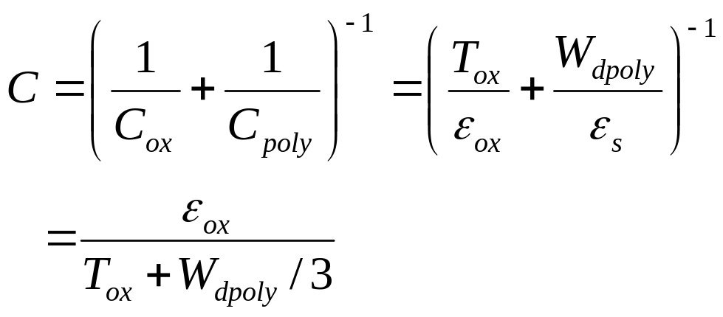
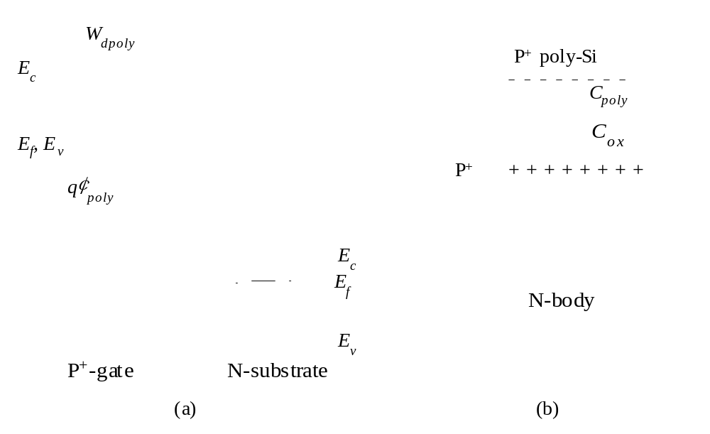
Poly-Silicon Gate Depletion–Effective
Increase in T_{ox}
Gauss’s Law
W
=
ε
E
/
qN
dpoly
ox
ox
poly
P⁺
If W_{dpoly}= 15 Å, what is the
effective increase in T_{ox}?

Slide 28
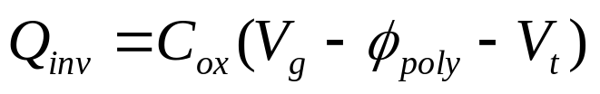
Effect of Poly-Gate Depletion on Q_{inv}
W
Poly-gate depletion degrades MOSFET current and circuit speed.
dpoly
E
c
How can poly-depletion be minimized?
E
f
,
E
v
q
φ
poly
E
c
E
f
E
v
P
+
-gate
N-substrate

Slide 29

Effective Oxide Thickness and Effective
Oxide Capacitance
T
=
T
+
W
/
3
+
T
/
3
oxe
ox
dpoly
inv
C
Basic CV
C
ox
with poly-depletion
with poly-depletion and
charge-layer thickness
measured data
V_{g}

Slide 30
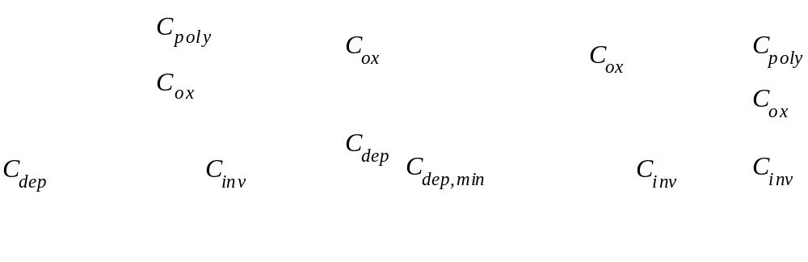
Equivalent circuit in the depletion and the inversion regimes
(a)
(b)
(c)
(d)
General case for both depletion and inversion regions.
In the depletion regions
V_{g} ≈ V_{t}
Strong inversion

Slide 31
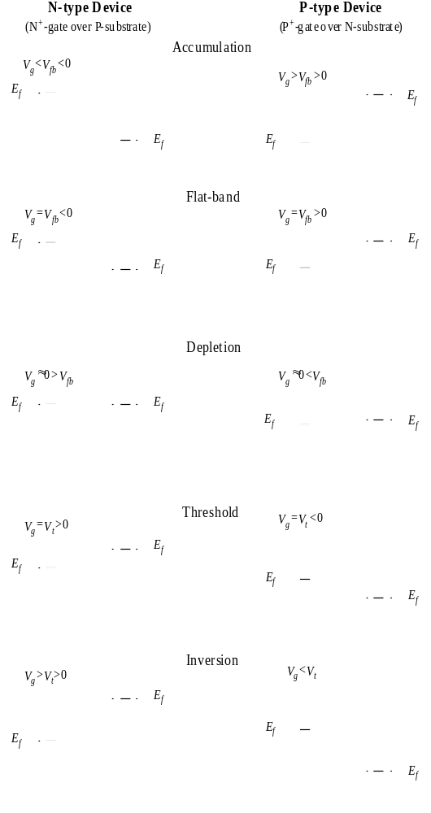
Chapter Summary
N-type Device
(N⁺-gate over P-substrate)
P-type Device
(P⁺-gate over N-substrate)
What’s the diagram like at V_{g} > V_{t} ? at V_{g}= 0?

